Slide 1
Graph-Enhanced Multi-Task Learning of Multi-Level Transition Dynamics for
Session-based Recommendation
汇报人：Gu Tang
时间：2021.3.13
Meeting:2021 AAAI
Code:None

Slide 2
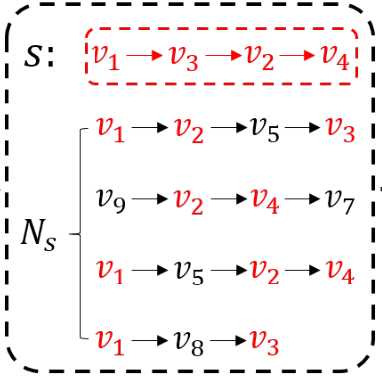
Motivation
V1
V2
V3
V4
V5
V7
V8
V9
V1
1
1
0
0
1
0
1
0
V2
0
0
0
1
1
0
0
0
V3
0
0
0
0
0
0
0
0
V4
0
0
0
0
0
1
0
0
V5
0
1
1
0
0
0
0
0
V7
0
0
0
0
0
0
0
0
V8
0
0
1
0
0
0
0
0
V9
0
1
0
0
0
0
0
0

Slide 3
Model Architecture

Slide 4
Model Architecture

Slide 5
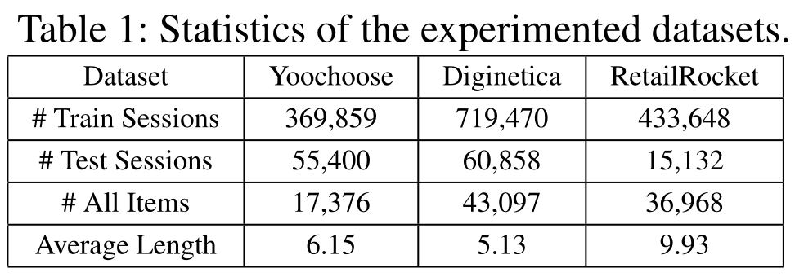
Experiment

Slide 6
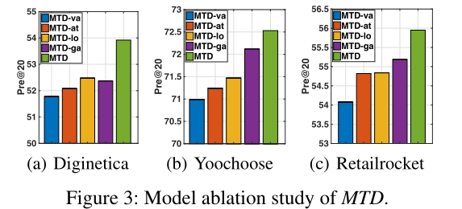
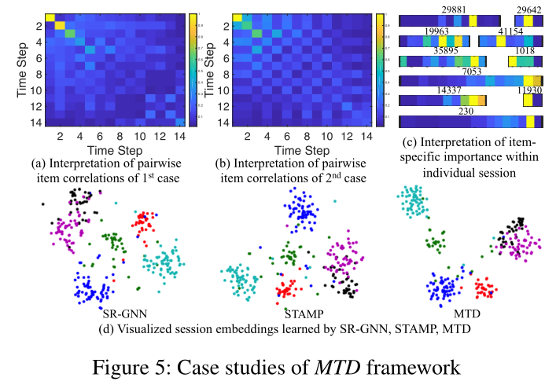
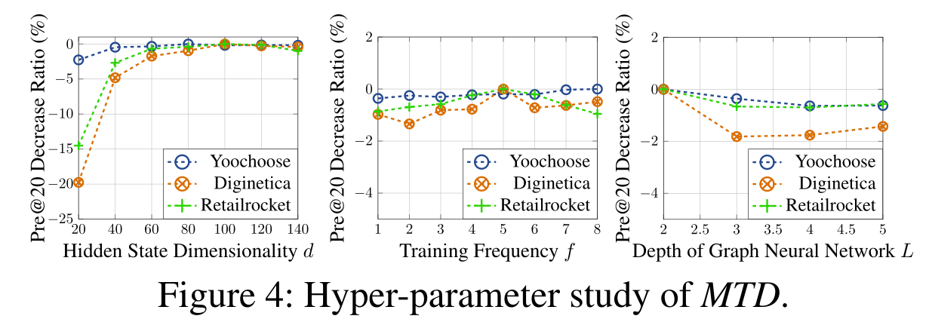
Experiment

Slide 7
THANGKS!

